Slide 1
PowerPoint Assignment
Learn using MS PowerPoint through 12 practical.
PowerPoint is commonly used for business presentations, lectures, and educational purposes, but it can also be used for personal projects such as creating photo albums or designing invitations. The software provides users with a wide range of tools to customize their presentations, including themes, templates, animations, and transitions. PowerPoint allows users to create slides that can include text, images, videos, and other multimedia elements.

Slide 2
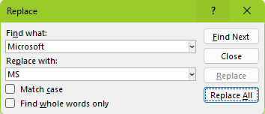
Practical 1-4
Replace the word “Microsoft” with “MS”.
Underline the “Microsoft –word” using underline option.
MS PowerPoint
is a software program developed by MS
THAT ALLOWS USERS TO CREATE VISUAL PRESENTATIONS.
It is a part of the MS Office suite,
which also includes Word, Excel, and other programs.

Slide 3
Practical 5
1. Professional-looking Presentations
2. Customizable Themes and Templates
3. Easy-to-Use Interface
4. Versatile Multimedia Integration
5. Effective Organization and Structure
6. Convenient Collaboration and Sharing
7. Time-Saving Auto-Formatting Features
8. Dynamic Animations and Transitions
9. Compatibility with Multiple Devices and Platforms
10. Broad Availability and Accessibility

Slide 4

Practical 6-7
Roll no. | Name | Course | Language
1. | Kapil | BCA | HTML
2. | Suresh | MCA | ASP.NET
3. | Shushma | B.COM. | TALLY

Slide 5

Practical 8-9
File
.ppt
New
.docx
Save
.pdf
THANK YOU

Slide 6
Practical 9-12
These slides can be arranged in a sequence to create a presentation, which can be displayed on a computer screen or projected onto a larger screen for an audience.

